Slide 1
SOFTWARE ENGINEERING
SOFTWARE MAINTENANCE
Software Maintenance is a very broad activity that includes error corrections, enhancements of capabilities, deletion of obsolete capabilities, and optimization.
Software maintenance is widely accepted part of SDLC now a days. It stands for all the modifications and updations done after the delivery of software product. There are number of reasons, why modifications are required, some of them are briefly mentioned below:
Market Conditions - Policies, which changes over the time, such as taxation and newly introduced constraints like, how to maintain bookkeeping, may trigger need for modification.
Client Requirements - Over the time, customer may ask for new features or functions in the software.
Host Modifications - If any of the hardware and/or platform (such as operating system) of the target host changes, software changes are needed to keep adaptability.
Organization Changes - If there is any business level change at client end, such as reduction of organization strength, acquiring another company, organization venturing into new business, need to modify in the original software may arise.
Dr Prabhat Kumar Vishwakarma

Slide 2
SOFTWARE ENGINEERING
TYPE OF SOFTWARE MAINTENANCE
In a software lifetime, type of maintenance may vary based on its nature. It may be just a routine maintenance tasks as some bug discovered by some user or it may be a large event in itself based on maintenance size or nature. Following are some types of maintenance based on their characteristics:
A) Corrective Maintenance - This includes modifications and updations done in order to correct or fix problems, which are either discovered by user or concluded by user error reports.
B) Adaptive Maintenance - This includes modifications and updations applied to keep the software product up-to date and tuned to the ever changing world of technology and business environment.
C) Perfective Maintenance - This includes modifications and updates done in order to keep the software usable over long period of time. It includes new features, new user requirements for refining the software and improve its reliability and performance.
D) Preventive Maintenance - This includes modifications and updations to prevent future problems of the software. It aims to attend problems, which are not significant at this moment but may cause serious issues in future.
Dr Prabhat Kumar Vishwakarma

Slide 3
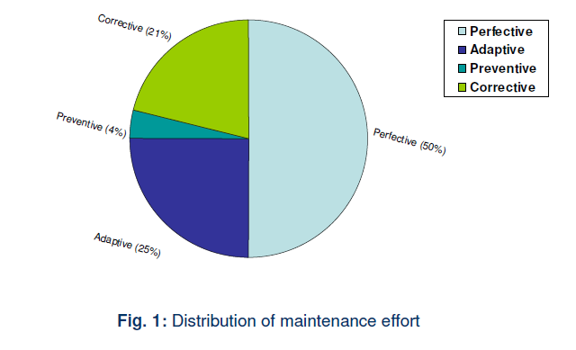
SOFTWARE ENGINEERING
TYPE OF SOFTWARE MAINTENANCE
Dr Prabhat Kumar Vishwakarma

Slide 4
SOFTWARE ENGINEERING
PROBLEMS OBSERVED DURING SOFTWARE MAINTENANCE
Often the program is written by another person or group of persons.
Often the program is changed by person who did not understand it clearly.
Program listings are not structured.
High staff turnover.
Information gap.
Systems are not designed for change.
Dr Prabhat Kumar Vishwakarma

Slide 5
SOFTWARE ENGINEERING
SOLUTIONS OF MAINTENANCE PROBLEMS
  Budget and effort reallocation
  Complete replacement of the system
  Maintenance of existing system
Dr Prabhat Kumar Vishwakarma

Slide 6
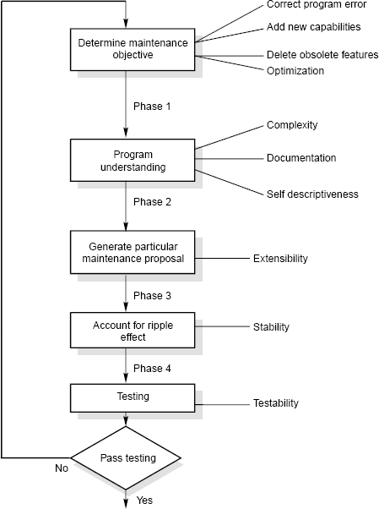
SOFTWARE ENGINEERING
MAINTENANCE PROCESS
Dr Prabhat Kumar Vishwakarma

Slide 7
SOFTWARE ENGINEERING
MAINTENANCE PROCESS
Program Understanding
The first phase consists of analyzing the program in order to understand.
Generating Particular Maintenance Proposal
The second phase consists of generating a particular maintenance proposal to accomplish the implementation of the maintenance objective.
Ripple Effect
The third phase consists of accounting for all of the ripple effect as a consequence of program modifications.
Modified Program Testing
The fourth phase consists of testing the modified program to ensure that the modified program has at least the same reliability level as before.
Maintainability
Each of these four phases and their associated software quality attributes are critical to the maintenance process. All of these factors must be combined to form maintainability.
Dr Prabhat Kumar Vishwakarma

Slide 8
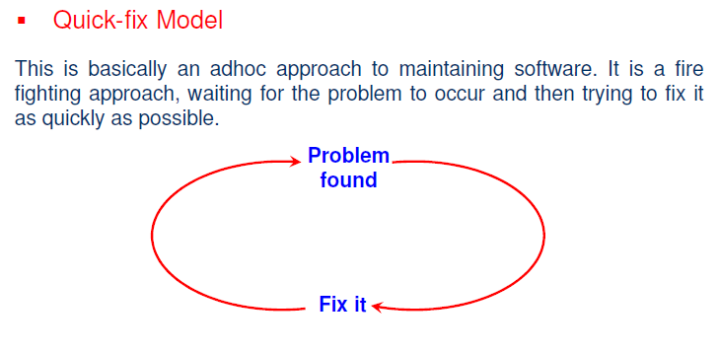
SOFTWARE ENGINEERING
MAINTENANCE MODELS
Dr Prabhat Kumar Vishwakarma

Slide 9
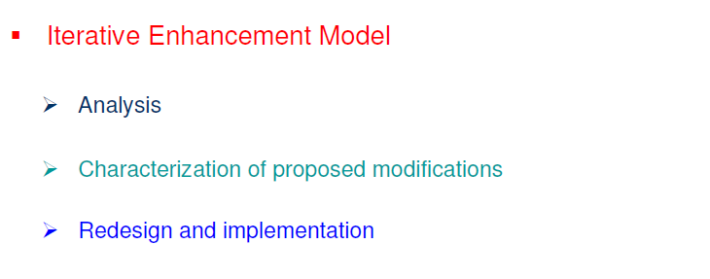
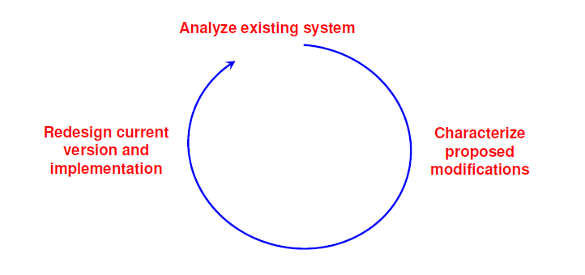
SOFTWARE ENGINEERING
MAINTENANCE MODELS
Dr Prabhat Kumar Vishwakarma

Slide 10
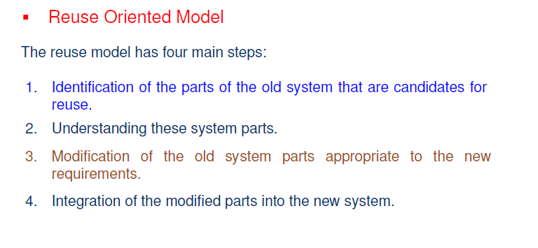
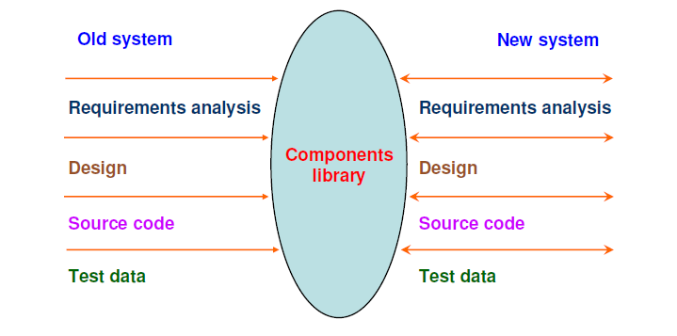
SOFTWARE ENGINEERING
MAINTENANCE MODELS
Dr Prabhat Kumar Vishwakarma

Slide 11
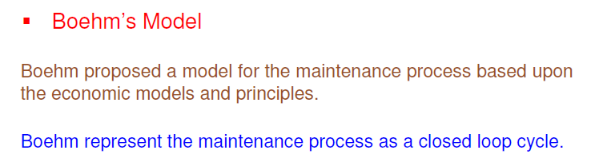
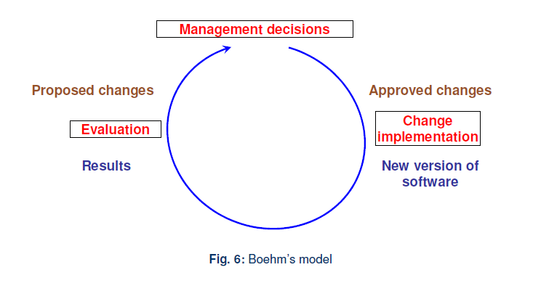
SOFTWARE ENGINEERING
MAINTENANCE MODELS
Dr Prabhat Kumar Vishwakarma

Slide 12
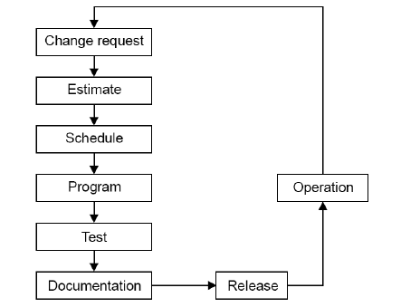
SOFTWARE ENGINEERING
MAINTENANCE MODELS
Taute Maintenance Model
It is a typical maintenance model and has eight phases in cycle fashion. The phases are shown as
Dr Prabhat Kumar Vishwakarma

Slide 13
SOFTWARE ENGINEERING
MAINTENANCE MODELS
Taute Maintenance Model
It is a typical maintenance model and has eight phases in cycle fashion. The phases are shown as
Dr Prabhat Kumar Vishwakarma

Slide 14
SOFTWARE ENGINEERING
Developmental Testing Vs Regression Testing
Sr. No. | Development testing | Regression testing
1. | We create test suites and test plans | We can make use of existing test suite and test plans
2. | We test all software components | We retest affected components that have been modified by modifications.
3. | Budget gives time for testing | Budget often does not give time for regression testing.
4. | We perform testing just once on a software product | We perform regression testing many times over the life of the software product.
5. | Performed under the pressure of release date of the software | Performed in crisis situations, under greater time constraints.
Dr Prabhat Kumar Vishwakarma

Slide 15
SOFTWARE ENGINEERING
Reverse Engineering
Reverse engineering is the process followed in order to find difficult, unknown and hidden information about a software system.
Reverse Engineering encompasses a wide array of tasks related to understanding and modifying software system. This array of tasks can be broken into a number of classes.
Dr Prabhat Kumar Vishwakarma

Slide 16
SOFTWARE ENGINEERING
Reverse Engineering
The areas there reverse engineering is applicable include (but not limited to):
  Program comprehension
  Redocumentation and/ or document generation
  Recovery of design approach and design details at any level of abstraction
  identifying reusable components
  Identifying components that need restructuring
  Recovering business rules, and
  Understanding high level system description
Dr Prabhat Kumar Vishwakarma

Slide 17
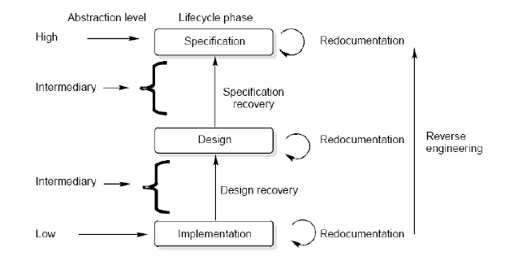
SOFTWARE ENGINEERING
Levels of Reverse Engineering
Reverse Engineers detect low level implementation constructs and replace them with their high level counterparts.
The process eventually results in an incremental formation of an overall architecture of the program.
Dr Prabhat Kumar Vishwakarma

Slide 18
SOFTWARE ENGINEERING
Levels of Reverse Engineering
Redocumentation
Redocumentation is the recreation of a semantically equivalent representation within the same relative abstraction level.
Design recovery
Design recovery entails identifying and extracting meaningful higher level abstractions beyond those obtained directly from examination of the source code. This may be achieved from a combination of code, existing design documentation, personal experience, and knowledge of the problem and application domains.
Dr Prabhat Kumar Vishwakarma

Slide 19
SOFTWARE ENGINEERING
Software Re- Engineering
Software re-engineering is concerned with taking existing legacy systems and re-implementing them to make them more maintainable.
The critical distinction between re-engineering and new software development is the starting point for the development as shown in Fig
Dr Prabhat Kumar Vishwakarma

Slide 20
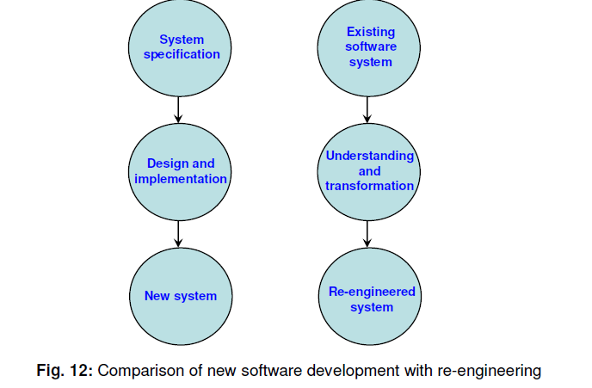
SOFTWARE ENGINEERING
Software Re- Engineering
Dr Prabhat Kumar Vishwakarma

Slide 21
SOFTWARE ENGINEERING
Configuration Management
The process by which software development and maintenance is controlled is called configuration management. The configuration management is different in development and maintenance phases of life cycle due to different environments.
Dr Prabhat Kumar Vishwakarma

Slide 22
SOFTWARE ENGINEERING
Configuration Management Activities
The activities are divided into four broad categories.
1.The identification of the components and changes
2.The control of the way by which the changes are made
3.Auditing the changes
4.Status accounting recording and documenting all the activities that have take place.
Dr Prabhat Kumar Vishwakarma

Slide 23
SOFTWARE ENGINEERING
Configuration Management Activities
The following documents are required for these activities
Project plan
Software requirements specification document
Software design description document
Source code listing
Test plans / procedures / test cases
User manuals
Dr Prabhat Kumar Vishwakarma

Slide 24
SOFTWARE ENGINEERING
Software Version
Two types of versions namely revisions (replace) and variations (variety).
Version Control :
A version control tool is the first stage towards being able to manage multiple versions. Once it is in place, a detailed record of every version of the software must be kept. This comprises the
Name of each source code component, including the variations and revisions
The versions of the various compilers and linkers used
The name of the software staff who constructed the component
The date and the time at which it was constructed
Dr Prabhat Kumar Vishwakarma

Slide 25
SOFTWARE ENGINEERING
Documentation
Software documentation is the written record of the facts about a software system recorded with the intent to convey purpose, content and clarity.
    User Documentation
S.No. | Document | Function
1. | System Overview | Provides general description of system’s functions.
2. | Installation Guide | Describes how to set up the system, customize it to local hardware needs and configure it to particular hardware and other software systems.
3. | Beginner’s Guide | Provides simple explanations of how to start using the system.
4. | Reference Guide | Provides in depth description of each system facility and how it can be used.
5. | Enhancement | Booklet Contains a summary of new features.
6. | Quick reference card | Serves as a factual lookup.
7. | System administration | Provides information on services such as net- working, security and upgrading.
Dr Prabhat Kumar Vishwakarma

Slide 26
SOFTWARE ENGINEERING
Documentation
    System Documentation
    It refers to those documentation containing all facets of system, including analysis, specification, design, implementation, testing, security, error diagnosis and recovery.
Dr Prabhat Kumar Vishwakarma

Slide 27
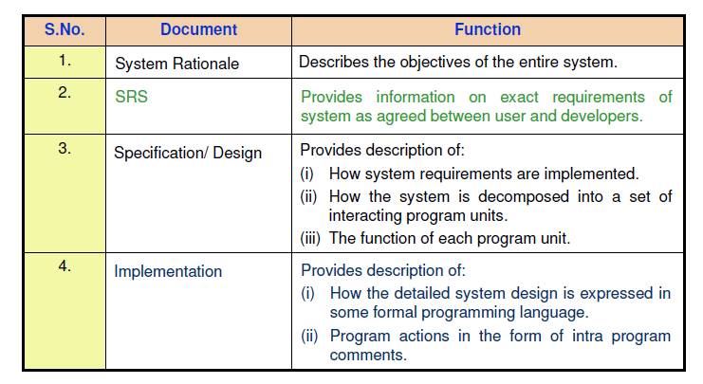
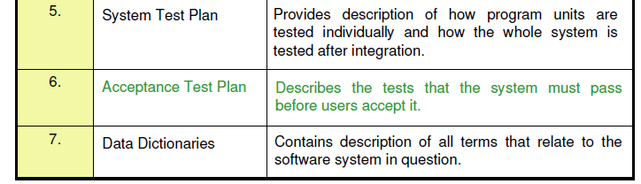
SOFTWARE ENGINEERING
Documentation
    System Documentation
Dr Prabhat Kumar Vishwakarma

